Slide 1
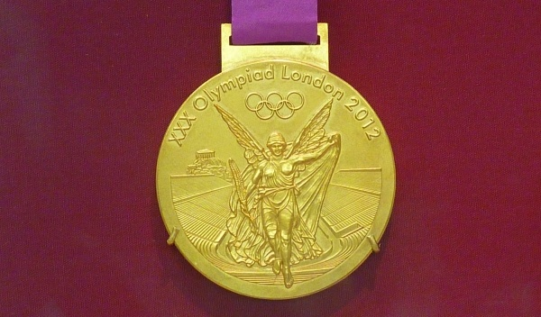
Serial Winning Coaches

Slide 2

Ausgangspunkt
The Innovation Group of Leading Agencies (ICCE)
Was zeichnet international erfolgreiche Top-Trainer aus?
Serial Winning Coaches. Kriterien:
Mehrfache Titelgewinner bei Europa-, Weltmeisterschaften oder Olympischen Spielen, bzw. in Nationalen Topligen.
erfolgreich mit mehreren Teams/Athleten/innen.
Welche Persönlichkeit haben diese Top-Trainer (Die Person)
Was tun sie? (Die Praxis)
Wie wurden sie erfolgreich? (Der Weg)
Welche Rückschlüsse lassen sich für die künftige Ausbildung von Spitzentrainern daraus ziehen?

Slide 3
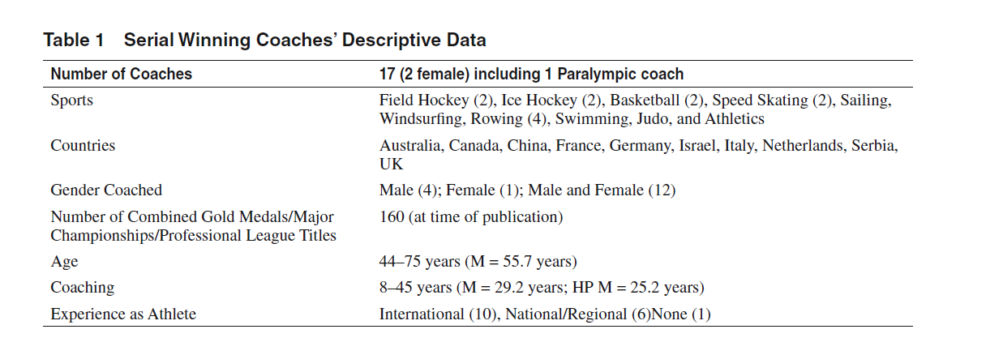
17 Trainer/innen aus 10 Nationen
Zusätzlich 19 Athleten/innen von 11 Trainer/innen

Slide 4
Methodik
Fragebogen Lebenslauf
NEO FFI (Big Five) und Personal Strivings (Emmons)
halbstrukturiertes Interview
Beispielfragen: ‘What personal qualities do you think have helped you/your coach to become a SWC?‘ ‘ What is it that you do/your coach does that has allowed you/her to become a SWC?‘. ‘Have there been any critical moments in your coaching career

Slide 5
Ergebnisse
Notes:
4 zentrale Themen:
Trainerphilosphie, Vision bzw. Zielvorstellungen, Führungsqualität, Gestalten des Umfelds

Slide 6
Trainerphilosophie
Athlet im Mittelpunkt
hohe moralische Wertvorstellungen (Ehrlichkeit, Loyalität, Respekt)
Work-life Balance (selbst & Athlet)
Notes:
Der Athlet steht im Mittelpunkt und sonst niemand, Athlet fühlt sich gesehen und respektiert und nicht nur als Athlet sondern als Mensch! „Er kümmert sich und zwar um jeden im Team“

Slide 7
Vision/Ziele
klare Vorstellung was nötig ist, um erfolgreich zu sein
Langfristige Planung (was ist notwendig um Ziel A, B, C, zu erreichen)
Fokus auf das Wesentliche
Notwendigkeit der Innovation
ständiges Monitoring & Reviewing
Notes:
klare Vorstellung was nötig ist, um erfolgreich zu sein: The ability to predict, particularly with regards to what ‘it will take to win a gold medal or championship the next time around’
Langfristige Planung (was ist notwendig um Ziel A, B, C, zu erreichen) (Action Led Planning)
Fokus oder Simplifying Complexity: In the high performance environment, time, attention and resources are limited and having clarity about where the biggest return on investment is appears central to SWC practice. In addition, being able to maintain “focus on the big prize” (Athlete 11) and ignore myriad potential distractions along the way was identified as critical to success.
Notwendigkeit der Innovation
Monitoring & Reviewing
Athletes highlighted that one of the most important elements of the review process SWC engaged in revolved around the monitoring of athlete progress and performance. While recognising the “painstaking and stressful nature” of this process (Athlete 11), they stressed the contribution it made to the creation of a culture of accountability and responsibilityThis also acted as a motivating factor for athletes who, due to the close monitoring of performance, felt “training was customised to suit their needs and stage of development”

Slide 8
Der Trainer als Führungspersönlichkeit
Team/Staff Auswahl entscheidend (Ziele, Charakter)
Glaube an den Trainer
Glaube an Dich
Glaube an uns
Notes:
[you need to build a group] in which players are comfortable with their roles and where at least they accept it, not always happily, but with a positive
attitude to contribute to the project. A group where beside the legitimate personal and individual aspirations, what’s at the forefront of everyone’s mind is the team’s success.
Glaube an den Trainer
The two most frequently identified sources of belief in the coach were the coach’s social capital (past as athlete, previous wins) and his/her ability to develop a positive bond with the athlete and/or the team (i.e., personal touch, open and honest communications, integrity, empathy, holistic approach to athlete development, being reliable and emotionally stable).
Glaube an Dich als Athlet (durch Coaching) he is very perfectionistic, so he really focuses on the details, but he is very good at positive coaching, he does not only say what you are doing wrong, but he says what you are doing well and this combination makes him a champion maker.
Glaube an uns das Team (Führungsqualität des Trainers, Teamführung, Identität) „bring
the team together as people.”
In addition, a number of athletes indicated that, at times, their coach deliberately created instances of “crisis” (Athlete 2), which brought the team together (sometimes even against the coach)
Keep athletes rootet
Overall, there was an emphasis on the coach’s aptitude to build and manage relationships with every stakeholder and member of the entourage.
Athletes tended to see the relationship with their coach as much more of a partnership than an autocracy. Some athletes reported this as a departure from previous experiences of coaching and, while still respecting the coach’s ultimate decision-making power, stressed that authoritarian approaches were on the decline and would not work going forward.

Slide 9
Strukturen
Hohe Erwartungen /Anforderungen
jeden Stein umdrehen
Herausforderungen kreieren
Stabilität & Verlässlichkeit
Einfluss des Trainers nach oben
Notes:
Entwicklung des Trainers während der Karriere aus Athletensicht
mehr Milde/Güte
flexibler in Planung
Verbesserung in Fähigkeit Strukturen des Leistungssport zu managen
Hohe Erwartungen “as soon as you walked in there, you knew how to behave in that environment, the culture was everywhere”
Jeden Stein umdrehen
Herausforderungen kreieren
Stabilität & Verlässlichkeit
Einfluss des Trainers nach oben

Slide 10
Unterschiede zu anderen Trainern
Was ist einzigartig an Serial Winnern? (Athletensicht)
Wissen, Können, Glaubwürdigkeit
Sozialkompetenz (Soft Skills) wie Einfühlungsvermögen, Aufgeschlossenheit, Überzeugungskraft, Selbstreflexion,
Notes:
The coach’s professional skills like work ethic, his/her credibility and their overall knowledge and skill level were all highlighted.
However, athletes tended to place greater emphasis on the inter- and intrapersonal skills (i.e., soft skills) of the coach (e.g., empathy, persuasiveness, open-mindedness, self-awareness).

Slide 11
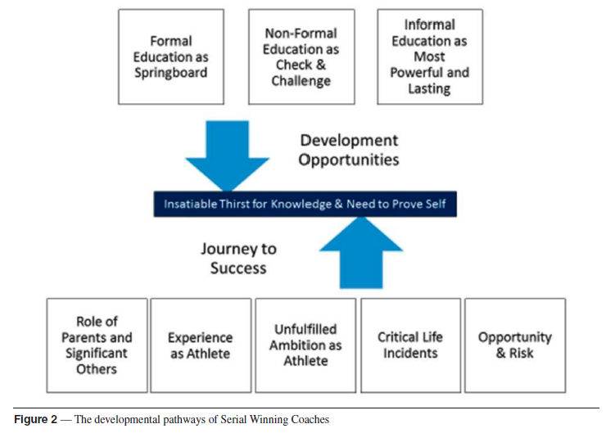
Der Weg der Serial Winning Coaches
Notes:
Studium (13 von 17) Mehrzahl davon in Sportbezogenen Studiengängen (critical thinking, planning, and management skills bzw. Grundlage an theoretischem Wissen)
15 von 17 haben höchste Trainerlizenzen in eigener Sportart.
Formelle Ausbildung war wichtig aber: formal education, to be effective, needed to be relevant and delivered by credible and capable coach developers. As Coach 6 put it “I hate token coach education; it’s pointless”.

Slide 12
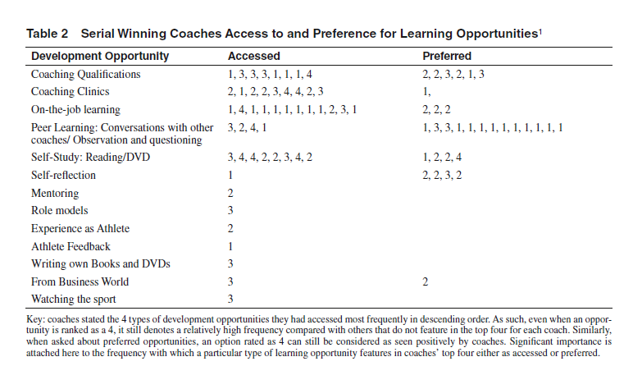
Der Weg der Serial Winning Coaches
Notes:
SWC ranked coaching qualifications, coaching clinics, on the-job learning and self-study as the most commonly accessed learning opportunities.
On the other hand, peer learning was consistently rated as the preferred learning opportunity by SWC followed by coaching qualifications, self-study, self-reflection and on-the-job learning (see Table 2).
Die Idee des Mentoring tauchte besonders in den Interviews auf. Häufig gab es in der Karriere der SWC „Mentoren“, die als Vorbilder dienten. Häufig informell. 2 der SWC haben z.B. auch Mentoren im Trainerteam fest intalliert.

Slide 13
Der Weg der Serial Winning Coaches
Wissensdurst
Selbstreflexion
Offenheit
Notes:
Persönlichkeitsfragebögen zeigen folgende Eigenschaften:

